Slide 1


Project Team_Moon
Mental Health - Anxiety 2020

Slide 2
Outline
Topic Overview
Data Source
Scope of the Project
Data Discovery
Analysis and Findings

Slide 3
Topic Overview

Slide 4
Topic
Mental health care access with a focus on those with a diagnosis with anxiety.

Slide 5
Mental Health - Anxiety
[SPECIFIC TYPE OF] machine learning was used to classify which underlying attributes contribute to predicting an anxiety diagnosis.
The topic will additionally focus on the year of 2020 and look at the demographics of mental health factors such as, race, gender, age, state.
The topic was chosen due to the relevance it has on today’s society.

Slide 6
Scope of the Project
1

Slide 7
The driving questions for this analysis were:
What factors about a patient increase their likelihood of being diagnosed with anxiety disorders?
Are anxiety diagnoses more prevalent in certain areas of the country, or across certain demographic groups?
What states are more likely to have higher rates of mental health issues in relation to population?
What is the gender breakdown of mental health by state, region or division?

Slide 8
Data Discovery
The data was gathered from the Substance Abuse and Mental Health Data Archive (SAMHDA). They are one of the leading sources for behavioral health data in the United States. We were able to find data from 2013 - 2020. As a team we settled on 2020, as it was the most relevant timeframe.
The data provided was over 6 million line items and covered many areas of mental health diagnosis and demographics. As an item of note, we found it interesting that marital status was a hard topic to admit too. 43% of the participants were never married, 42% Unknown and only 15% admitted to being either married, separated , divorced or widowed.

Slide 9
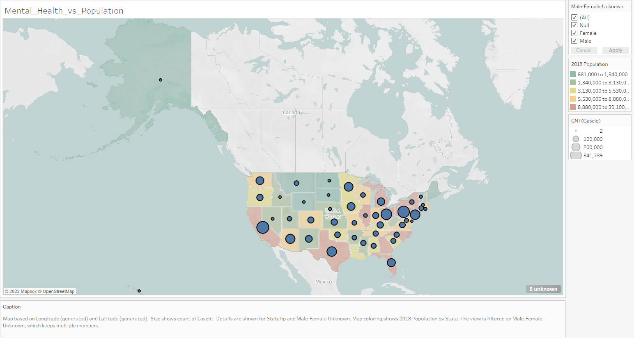

Slide 10
Graphs
Now that you’ve justified your attention to the problem, summarize your solution in one or two sentences.

Slide 11
Graphs
Now that you’ve justified your attention to the problem, summarize your solution in one or two sentences.

Slide 12
Analysis - Findings

Slide 13
Machine Learning 1: Supervised Logistic Regression

Slide 14
Machine Learning 2: Random Forest

Slide 15
Machine Learning 3: Neural Network

